Slide 1
COVID-19 Dashboard
in the Lehigh Valley
by DreamTeam: Basit Balogun, Edward Carl, Chloe Dorward, Seth Markarian, Matthew Sabatino

Slide 2
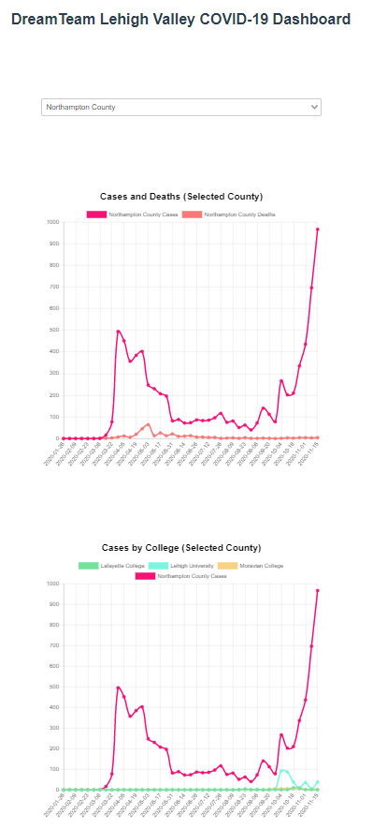
UI
Line graphs
Color coded key
Show/Hide key elements
Hover over different dates to see exact counts
Variable axis
Dropdown menu to select different counties in Pennsylvania
Notes:
To display our data, we chose to use four line graphs like the one displayed here. Each graph has a color coded key. Clicking on an element in the key will hide that line on the graph, and the variable axis will rescale to adjust. The user can hover over the lines to view the exact values over time.
There is also a drop down menu that changes which county’s data is displayed on graphs one and two.

Slide 3
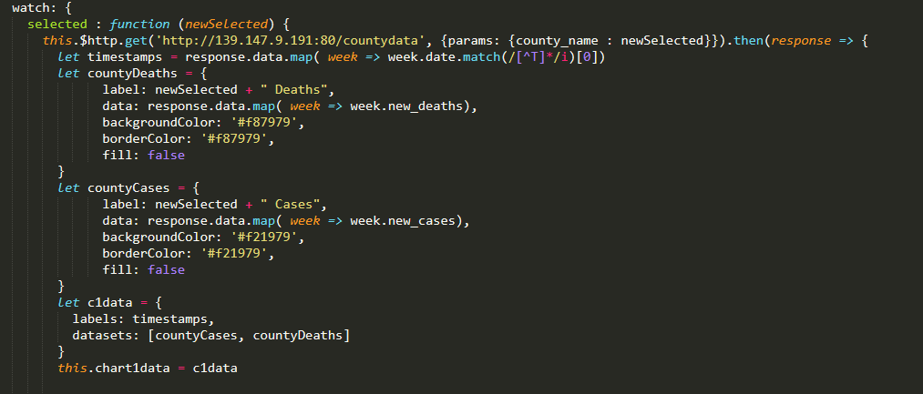
Frontend Implementation
Single-page app made with Vue
Easy modularity and reactivity
Charts implemented as custom Vue components based on vue-chartjs
Custom props allow easy configuration of each chart
Used Axios as HTTP client to retrieve information from API
Chart data and county selection options populated from database
Number of unique plot colors scales with datasets returned by API
Notes:
Our frontend is a single-page web app made with the Vue.js framework. Vue is arguably the easiest of the major frontend JavaScript frameworks to pick up, and enables a high degree of modularity and reactivity in the page. Our app uses a the vue-chartjs library to implement charts from the chart.js library as highly customizable Vue components.
Vue’s features allow us to build our website with minimal hard-coding of values. The contents of every chart, and even the drop-down menu for selecting counties, are determined at runtime from the results of HTTP requests made via the JavaScript library Axios. Our page can scale to an arbitrary number of counties and colleges, generating menu options, datasets and unique chart colors for each.

Slide 4
REST API
Built using express.js and pg (a PostgreSQL client)
Used to serve our static webpage
Enables our Vue application (frontend) to connect with the PostgreSQL database

Slide 5
REST API Implementation
Created a node app utilizing express.js framework and postgres client “pg”
Served the content of the app on port 80
Converted vue app into a static website
Routes created as get requests on http://139.147.9.191:80
‘/’ : Serves the static web page
‘/counties’ : Returns all the county names and population
‘/colleges’ : Returns college name, county and fall start date
‘/countycollege’ : Returns college name, county and fall start date for the requested county
‘/countydata’ : takes in county name and returns name, date, new cases, and death on a weekly basis
‘/collegedata’ : takes in college name and returns name, date, new cases on a weekly basis
‘/valleydata’ : Returns date, new cases and cumulative cases in the lehigh valley

Slide 6
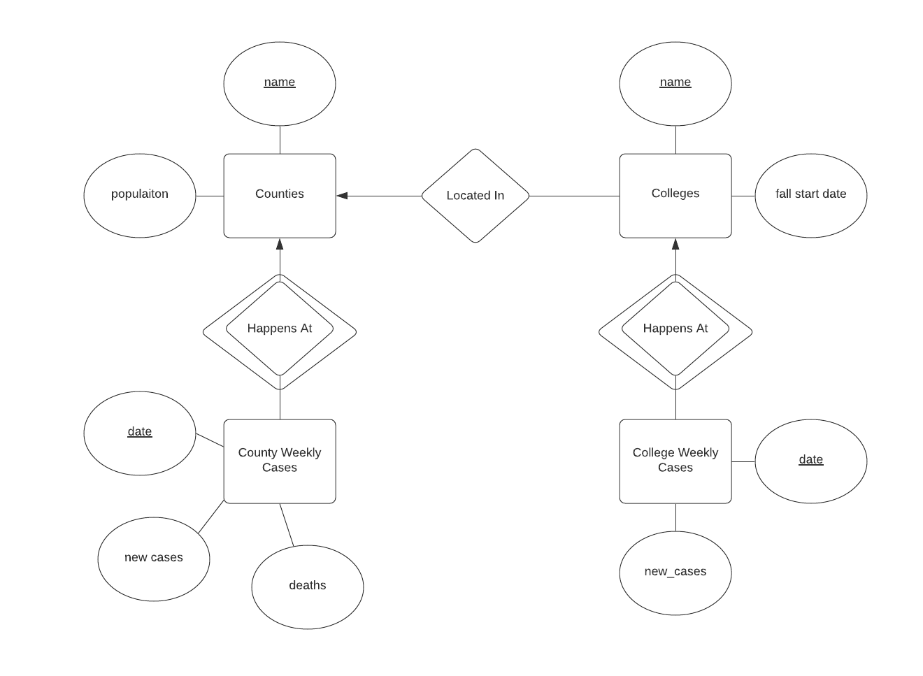
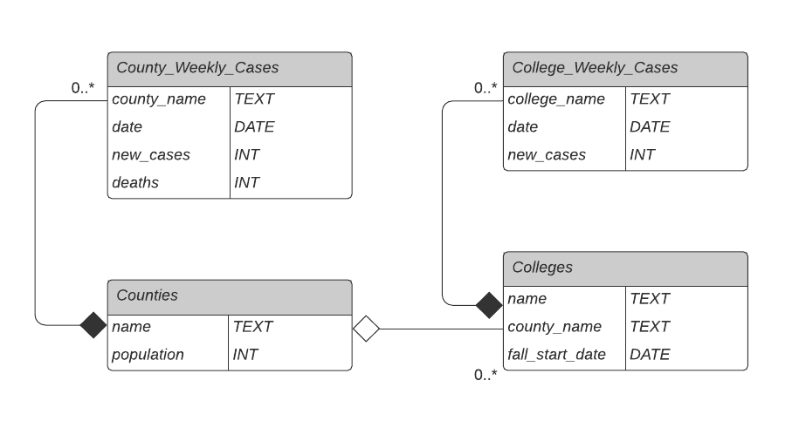
Database Design
Database Schema

Slide 7
Demo

